Slide 1
STRESS ECHO
Dr Ajay Nair
SeniorResident
Dept of Cardiology
Calicut MedicalCollege

Slide 2
Based on the relationship between induced myocardial ischemia and RWMA.
In the absence of a flow limiting coronary lesion:
PHYSIOLOGIC STRESS
INCREASED HR AND CONTRACTILITY
INCREASED MYOCARDIAL BLOOD FLOW
HYPERCONTRACTILE RESPONSE WITH INCREASED EF AND DECREASED ESV

Slide 3
CORONARY BLOOD FLOW RESERVE
Ability to increase CBF above resting values in response to stress.
Maximal CBF/Basal CBF
Resting blood flow remains constant up to 85% diameter stenosis.
CFR begins to decrease when stenosis reaches 50% of diameter.
CFR is abolished when stenosis reaches 90%

Slide 4
ISCHEMIC CASCADE

Slide 5
RWMA
AT REST | AT STRESS
INFARCTION | ISCHEMIA
CARDIOMYOPATHY | TRANSLATIONAL CARDIAC MOVEMENT
MYOCARDITIS | MARKEDLY INCREASED BP
LBBB | CARDIOMYOPATHY
HYPERTENSION | RATE DEPENDENT LBBB
HIBERNATING MYOCARDIUM | PULMONARY HYPERTENSION
STUNNED MYOCARDIUM
TOXINS
POSTOPERATIVE STATE
PACED RHYTHM
RV VOLUME / PRESSURE OVERLOAD

Slide 6
TYPES OF STRESSORS
EXERCISE STRESS | NON EXERCISE STRESS
TREADMILL | DOBUTAMINE
SUPINE BICYCLE | DIPYRIDAMOLE
UPRIGHT BICYCLE | DOBUTAMINE /DIPYRIDAMOLE COMBINATION
HANDGRIP | ADENOSINE
STAIR STEP | PACING

Slide 7
EXERCISE STRESS ECHO
TREADMILL
ADVANTAGES
Widely available
Relatively simple protocols
Preserves the additional information already available from TMT.
DISADVANTAGES
Imaging is restricted to the immediate post exercise period.
The ischemia may resolve quickly and hence the window for image acquisition is small. ( 1 to 1.5 minutes)

Slide 8
Additional information obtained from exercise stress echo
Exercise capacity.
Reproducibility of symptoms with activity.
Heart rate and BP response to exercise.
Detection of stress induced Arrythmias, control of angina on OMT.

Slide 9
TREADMILL STRESS ECHO PROTOCOL
Prepare patient
Obtain rest echo images
Perform standard TMT
Pt moves ASAP after exercise to examination table.
Post exercise images acquired and recorded
Both set of images are compared

Slide 10
SUPINE BICYCLE ERGOMETRY
Patient positioned on a supine bicycle ergometer with roughly 30⁰ head up tilt.
Rest images obtained
Exercise started at a workload of 25 W and a cadence of 60 rpm.
Workload is increased by 25 W every 2 minutes
Images obtained throughout exercise and at peak exercise.
After exercise images are obtained to look for normalization of WMA

Slide 12
Bicycle ergometry
Difficult for some patients
Ischemia is induced at lower heart rates because of greater increase in preload and a greater BP response.

Slide 13
Treadmill vs Supine bicycle
Advantage
Wide spread availability
Simple protocol
High work load
More specific
Disadvantage
Imaging post exercise only
Advantage
Imaging possible through out the exercise-especially peak exercise.
Onset of RWMA
Better image quality
Applying contrast easier
More sensitive
Disadvantage
Lower work load acheivable
Supine position affects exercise physiology.

Slide 14
PHARMACOLOGIC STRESS TESTING

Slide 15
Exercise as a Stressor
Drawbacks
Hyperventilation
Hypercontractility of Normal Walls
Excessive Tachycardia
Excessive chest wall movement
Unable to exercise at all or maximally
Circumvented by Pharmacological Stressers

Slide 16
Preferring pharmacologic stress echo over exercise stress echo
INABILITY TO EXERCISE
WHEN MYOCARDIAL VIABILITY IS AN ISSUE

Slide 17
DOBUTAMINE STRESS ECHO
DOBUTAMINE
A synthetic catecholamine
Ionotropic and chronotropic effects
Acts on :α , β1 and β2 receptors.
Ionotropic effect at lower doses and more of chronotropic effect at increasing doses.
Peripheral effects are unpredictable – vasodiln or vasoconstriction.
Net effect is an increase in contractility, heart rate and myocardial oxygen demand.
Metabolized hepatically & in peripheral tissues but no dose reduction is needed in hepatic or renal Dysfn
No dose reduction needed in the elderly

Slide 18
EXERCISE VS DOBUTAMINE STRESS ECHO
Increase in venous return less augmented with Dobutamine.
Lower increase in HR and greater augmentation of contractility with dobutamine. Hence ischemia often develops at much lower heart rates.
A decrease in BP generally signifies extensive ischemia. During dobutamine infusion it may be due to development of LVOT gradient which can be identified with a Doppler.
ECG evidence of ischemia is less reliable during Dobutamine infusion than it is during exercise stress testing.
Thus neither ST depression nor elevation occurring in the absence of RWMA is an indication for terminating the test.

Slide 19
PROTOCOL FOR DOBUTAMINE STRESS ECHO
Patient is prepared
4 hrs fasting
All negative ionotropic and chronotropic agents held for 8 to 12 hrs.
i.v access obtained.
Baseline images obtained
Continuous ECG and BP monitoring established
Dobutamine infusion started @ 5 or 10 µg/kg/min.
Rate increased every 3 minutes to doses of 10,20,30 and 40 µg/kg/min .
Low dose images acquired at the first sign of increased contractility ( at doses of 5 or10 µg/kg/min)
For viability assessment the initial dose is 2.5 µg/kg/min

Slide 20
Atropine can be given in aliquots of 0.5 to 1.0 mg during mid and high dose stages
-If THR not achieved
-Max dose 2mg
Mid dose images acquired at either 20 or 30 µg/kg/min.
Peak images obtained just before termination of infusion.
Post stress images obtained after return to baseline.
Patient to be monitored till return to baseline.
A trial dose of 50 µg/kg/min maybe used if near THR achieved at 40.
Gentle hand, arm or leg exercise may be used for chronotropic augmentation.

Slide 21
Protocol for Dobutamine Stress Echo.

Slide 22
INDICATIONS TO TERMINATE THE DOBUTAMINE INFUSION DURING STRESS ECHO
1.Exceeding THR of 85% age predicted maximum.
2.Development of significant angina.
3.Recognition of a new wall motion abnormality.
4.A decrease in SBP > 20 mm Hg from baseline.
5.Sustained or symptomatic arrhythmias.
6.Limiting side effects or symptoms.
7.Severe HTN ( > 220/120 mmHG)

Slide 23
SAFETY
Safety has been studied extensively
Short t_{1/2} (2 minutes) , hence induced ischemia readily reversed by termination of infusion.
Severe cases - short acting i.v β Blocker, Esmolol or Metoprolol can be used.
Most common side effects – Minor arrythmias like VPCs or Atrial arrythmias.

Slide 24
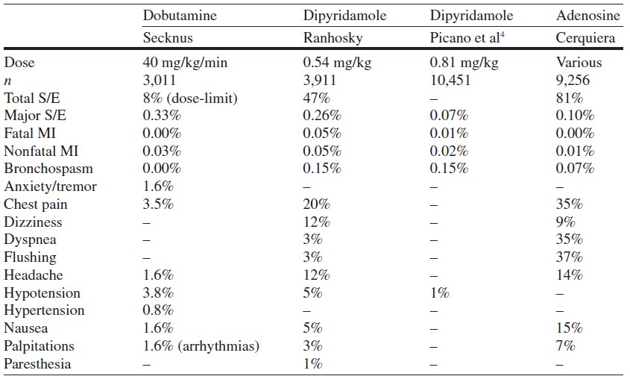

Slide 25
In one series of 1,118 patients referred for dobutamine stress echocardiography, there were no incidents of death, myocardial infarction, or sustained ventricular tachycardia or fibrillation (Mertes et al., 1993).

Slide 26
Dipyridamole
Potent coronary vasodilator
Provokes anginal attack in angina patients
Vasodilatory action:
Inhibition of reuptake of adenosine by endothelial cells
CBF increases 4 to 5 times in normal vessel
Reduction of subendocardial blood flow in stenotic coronary
arteries

Slide 27
Dipyridamole
Coronary steal phenomenon
Standard protocol: 0.54 mg/kg for 4 min
High dose protocol: 0.84mg/kg
Antidote: theophylline

Slide 28
Dipyridamole
Contraindication
active wheezing
high degree AV block
hypotension(SBP<90 mmHg)
recent use of dipyridamole(<24 hours)
Relative contraindication
Hx of reactive airway disease
sick sinus syndrome
severe sinus bradycardia

Slide 29
Adenosine
Naturally occurring agent
Receptors
A1: slows HR and conduction
A2a: c-AMP
Decreases calcium uptake by SR
Smooth muscle relax vasodilation
Half life: 2 seconds-Needs constant IV infusion
Rapidly removed by RBCs and endothelial cells.

Slide 30
Adenosine – side effect
Flushing: 37%
Dyspnea: 35%
GI discomfort: 15%
Headache:14%
Light-headedness 9%
Most side effect – short-lived and mild

Slide 31
CHOOSING BETWEEN PHARMACOLOGIC AGENTS
Dobutamine is more likely to cause true ischemia rather than a mere flow mismatch and thus a WMA is more likely to be detectable on Echo.
For inducing perfusion abnormality both Dobutamine and vasodilators are equivalent.
Thus Dobutamine is considered the agent of choice for stress Echo.

Slide 32
INTERPRETATION OF STRESS ECHO
HYPERKINESIS – The normal response to stress.
Lack of Hyperkinesis:
Myocardial ischemia
Non –ischemic CMP.
Beta blocker therapy
Severe hypertension
Delay in image acquisition
Elderly patients especially women

Slide 33
VOLUME RESPONSE
Decrease in ESV and EDV – Normal response
25-30% decrease in ESV and EDV is the normal response.
An abnormal volume response is defined as an increase in volume from rest to stress of > 17%.
However with Supine bicycle ergometry, due to increased venous return, an increase is LV volume may be a normal response.

Slide 34
USE OF CONTRAST AGENTS:
When endocardial borders can’t be properly identified in 2 or more LV segments contrast may be used.

Slide 35
HYPOKINESIS
HYPOKINESIS is the mildest form of abnormal wall motion.
It is defined as the preservation of thickening and inward motion of the endocardium during systole but less than normal.
It has been defined arbitrarily as less than 5 mm of endocardial excursion
Tardokinesis – a form of hypokinesis. Delayed, sometimes post systolic, inward motion or thickening.

Slide 36
Akinesis is defined as the absence of systolic myocardial thickening and endocardial excursion.
Dyskinesis is the most extreme form of a wall motion abnormality and is defined as systolic thinning and outward motion or bulging of the myocardium during systole.
A left ventricular segment that is thin and/or highly echogenic indicates the presence of scar.
Early Relaxation: A less common response
A segment appears to contract in early systole &
then relaxes earlier than other segments.
Most likely a normal variant
Cause of false positivity.

Slide 37
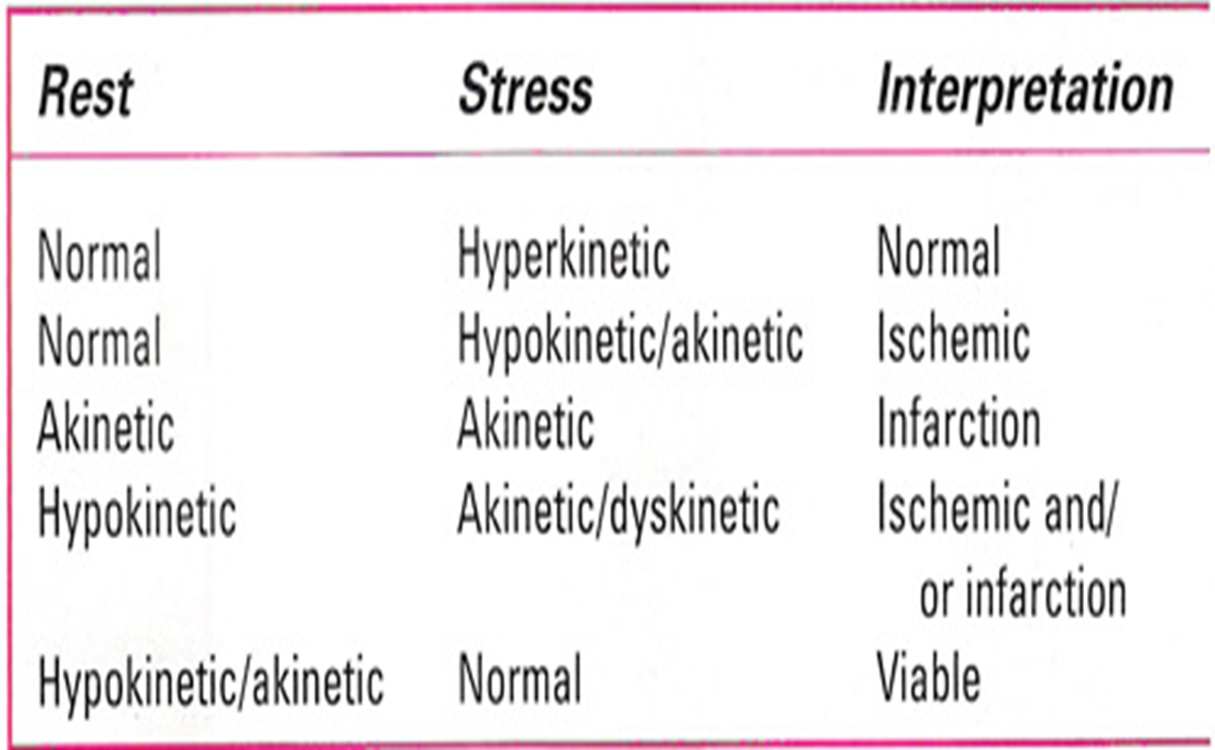

Slide 38
Segments that are abnormal at baseline but improve with stress are a special category and represent either:
1) A normal response
2) A localized abnormality with improvement due
to tethering effect of a normal segment.
3) With Dobutamine it may represent a viability
potential for recovery with revascularization.

Slide 39
LOCALIZATION OF CORONARY ARTERY

Slide 40
CORRELATION WITH SYMPTOMS AND ECG CHANGES
Usually concordant
When discordant, rely on Echo changes.
In fact one of the most common indications for stress echo are situations when Stress ECG may be false negative:
-LVH
-WOMEN
-LBBB
In a study using bicycle ergometry by Ryan et al. precise concordance between ECG and Echo occurred in nearly 50% cases and when disagreement did occur Echo was mostly correct.
However a strongly positive exercise stress test should not be ignored.

Slide 41
DETECTION OF CAD
Using CAG as the standard the overall sensitivity of Exercise Stress Echo has ranged from 71 to 94%.
Specificity ranges between 80 to 90%.
Studies on Dobutamine stress echo also gave similar results.
Stress ECG – Sensitivity – 77%
- Specificity – 68%
Factors affecting sensitivity- Degree of coronary stenosis
- Location of stenosis
- Presence of LVH

Slide 42
LBBB:
- Most common cause of false positive result
-Abnormal septal motion
-Myocardial thickening is however preserved.
-Trimming the loops to avoid the first few frames of
systole can be helpful.

Slide 43
ROLE OF MYOCARDIAL PERFUSION IMAGING
In theory, a perfusion defect must precede the development of a WMA.
Thus MPI should increase the sensitivity of the test to detect ischemia.
For a given stenosis, the spatial extent of the perfusion defect may exceed the WMA.
After injecting contrast, its distribution parallels blood flow and can be visualized as it traverses the microvasculature.
Thus perfusion can be assessed as
i) Relative change (Rest vs Stress)
ii)Regional difference(Lateral wall vs Septum)
In general the perfusion information supplements the WMA to detect CAD.

Slide 44
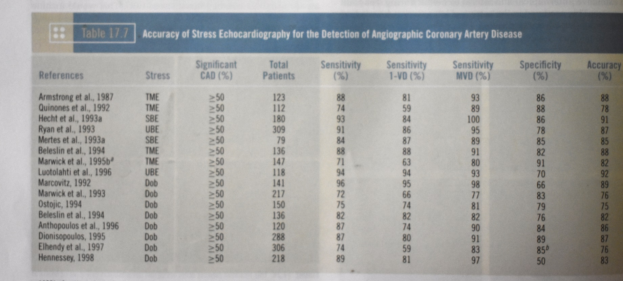
Comparision to nuclear perfusion imaging
 | Myocardial contrast echo | Nuclear perfusion imaging
SENSITIVITY | 84% | 82%
SPECIFICITY | 56% | 52%

Slide 45
Why Echo in comparison to SPECT, PET etc.
Low cost
Environment friendly
No ionizing radiation
Equally accurate

Slide 46
Prognostic Value of Stress Echocardiography
An abnormal exercise echocardiogram generally identifies patients at increased risk of cardiac events.
-A New wall motion abnormality
-Rest and exercise wall motion score index
-End-systolic volume response.
In most series, echocardiographic evidence of ischemia was the most potent marker of high-risk status

Slide 47
STRESS ECHO AFTER MI
Used both to identify high and low risk subsets and to predict the location and extent of CAD.
The goal is to identify ischemia at a distance
Positive finding would be detection of a new WMA remote from the site of previous infarction.
Inducible ischemia is a powerful indicator of high risk and suggests the need for further evaluation.

Slide 48
Preoperative Risk Assessment
Most studies used dobutamine stress.
Mainly before major peripheral vascular surgery and therefore included patients who frequently are unable to exercise.
In this high-risk subset, the presence or absence of an inducible WMA has been the most potent determinant of relative risk.
The absence of an inducible wall motion abnormality confers a very favorable prognosis, with a negative predictive value of 93% to 100%.

Slide 49
In a Meta-analysis examining the value of dipyridamole thallium and dobutamine echocardiography before vascular surgery (Shaw et al., 1996), the presence of an inducible wall motion abnormality on echocardiography provided the greatest ability to discriminate between high- and low-risk status

Slide 50
ASSESMENT OF MYOCARDIAL VIABILITY
The term viable refers to myocardium that has the potential for functional recovery.
The resting Echo is neither sensitive nor specific for this purpose.
The use of Dobutamine echo is basd on the observation that viable myocardium will augment in response to β adrenergic stimulation whereas non viable myocardium will not.
Dobutamine is infused at incremental rates and the response is carefully noted.
The BIPHASIC RESPONSE, i.e augmentation at low dose followed by deterioration at higher doses is most predictive of the capacity for functional recovery.

Slide 51
Sustained improvement
No change
Sensitivity : 80% to 85%
Specificity : 85% to 90%
Compared to Nuclear techniques: -Sensitivity is slightly low
-Specificity is higher
Non Viable

Slide 52
STRESS ECHO IN VALVULAR HEART DISEASE
AS
No role in patients with definite cardiac symptoms.
The principal role of exercise testing is to unmask symptoms or abnormal blood pressure responses in patients with AS who claim to be asymptomatic.

Slide 53
AS WITH LOW-FLOW, LOW-GRADIENT, AND LV DYSFUNCTION
Anatomically severe AS and LV systolic dysfunction (EF<40%) often presents with a relatively low-pressure gradient, such as a mean gradient of 30 to 40 mm Hg or less.
Difficult to differentiate them from a primary cardiomyopathic process and a thickened but nonstenotic aortic valve producing an outflow murmur-PSEUDOSEVERE AS

Slide 54
TRUE SEVERE AS- The small and relatively fixed AVA contributes to an increase in afterload, a decrease in ejection fraction, and a reduction stroke volume.
PSEUDOSEVERE AS-The predominant factor is myocardial disease
The severity of AS is overestimated on the basis of AVA because there is incomplete opening of the valve.

Slide 55
In both situations, the low-flow state and low-pressure gradient contribute to a calculated AVA that meets criteria for severe AS at rest (1.0 cm²)
The resting echocardiogram does not distinguish between these 2 situations
Distinction is essential because patients with true severe AS and poor LV function will generally benefit significantly from AVR.
Patients with pseudosevere AS will not and may also have a higher risk of perioperative mortality.

Slide 57
AR
Exercise testing may elicit symptoms in patients with AR who are apparently asymptomatic based on the medical history, thus identifying candidates for surgery.
In addition, pre-operative exercise capacity is helpful in predicting survival and recovery of function after AVR

Slide 58
MS
In asymptomatic patients with severe MS (mean gradient >10 mm Hg and mitral valve area [MVA] <1.0 cm²), or
Symptomatic patients with moderate MS (mean gradient of 5 to 10 mm Hg and MVA of 1.0 to 1.5 cm²)
The measurement of PAP (measured from the TR velocity) during exercise or dobutamine stress echo can help distinguish those who could benefit from valvuloplasty or valve replacement.

Slide 59
Patients with reduced atrioventricular compliance show a more pronounced increase in PAP during exercise or dobutamine than those with normal compliance
In some patients with Moderate MS at rest, the physiologic effects of heart rate sensitivity and atrioventricular compliance can produce exercise-induced pulmonary hypertension and exertional dyspnea.
The resting values of transmitral gradient and pulmonary arterial pressure do not necessarily reflect the actual severity of the disease
Stress echocardiography is useful for assessing the severity of MS, assessing its hemodynamic impact, and explaining exercise-induced symptoms.

Slide 60
The current ACC/AHA guidelines have given a Class I recommendation for stress echocardiography in patients with MS and discordance between symptoms and stenosis severity .
The threshold values proposed by the ACC/AHA guidelines for consideration for intervention are a mean transmitral pressure gradient >15 mm Hg during exercise or a peak pulmonary artery systolic pressure >60 mm Hg during exercise .
In these patients, BMV or Sx is recommended, even with apparently moderate MS at rest .

Slide 62
MR
Asymptomatic severe MR :Exercise stress echocardiography may help identify patients with unrecognized symptoms or subclinical latent LV dysfunction.
In symptomatic patients in whom the severity of MR is estimated to be only mild at rest, exercise echocardiography may be useful in elucidating the cause.

Slide 63
Worsening of MR severity
A marked increase in PAP
Impaired exercise capacity
Occurrence of symptoms during exercise echocardiography
Useful findings for identifying a subset of apparently asymptomatic patients at higher risk who may benefit from early surgery.
A pulmonary artery systolic pressure >60 mm Hg during exercise has been suggested as a threshold value above which asymptomatic patients with severe MR might be referred for surgical valve repair (Class IIa recommendation )

Slide 65
Prosthetic Heart Valves
Stress echocardiography -valuable in confirming or excluding the presence of hemodynamically significant prosthetic valve stenosis or PPM, especially when there is discordance between the patient's symptomatic status and the prosthetic valve hemodynamics measured at rest
In contrast to a normally functioning and well-matched prosthesis a stenotic prosthetic valve is generally associated with a marked increase in gradient with exercise

Slide 66
A disproportionate increase in transvalvular gradient (>20 mm Hg for aortic prostheses or >12 mm Hg for mitral prostheses) generally indicates severe prosthesis dysfunction or PPM
High resting and stress gradients occur more often with smaller (21 for aortic and 25 for mitral) rather than larger-sized prostheses, and mismatched rather than non mismatched prostheses.

Slide 67
THANK YOU

